Slide 1
Internet Protocol & Domain Name System
CSC 102 Lecture 2b
Nicholas R. Howe

Slide 2
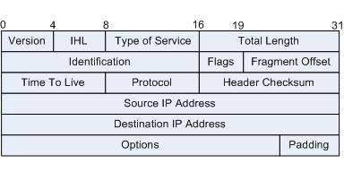
IP Packet Specifics
Header is usually 20 bytes long
160 bits
40 hexadecimal digits
Split into data fields of varying length
TTL is bits 64-71
Source IP is 96-127
Destination IP is 128-159
Converter
Header
Data
01100010101110010110010001010011001101001001…
6 2 B 9 6 4 5 3 3 4 9…
32 bits/ 4 bytes / 8 hexadecimal digits

Slide 3

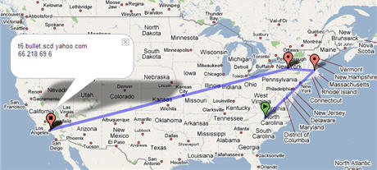
Activities
Ping lab
Traceroute lab

Slide 4
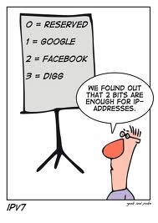
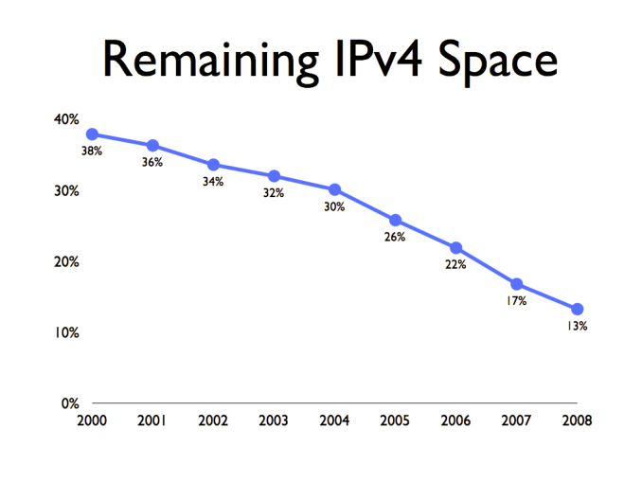
Address Availability
Q. 4 bytes in IP address. How many addresses?
A. 2³² adresses, or about 4 billion
Many allocated & unused (Smith has 65536)
More internet capable devices (e.g., smartphones)
We are running out of IP addresses!
What can be done?
have run

Slide 5


(Partial) Solution #1: DHCP
DHCP = Dynamic Host Configuration Protocol
Each host requests local IP address from a pool
Addresses are “leased” not “owned”
DHCP server hands out
IP addresses from a pool
215.68.17.67
215.68.17.0
Internet
215.68.17.114

Slide 6
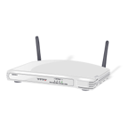
Solution #1: DHCP + NAT
NAT = Network Address Translation
DHCP server has only “real” IP address
Assigns fake addresses in special reserved blocks
Alters addresses on inbound/outbound packets
192.168.1.1
Home routers offer DHCP with NAT
215.68.17.0
(outward facing IP)
192.168.1.0
(inward facing IP)
Internet
192.168.1.2
Notes:
192.168.X.X, 10.X.X.X, 172.16.0.0-172.31.255.255

Slide 7
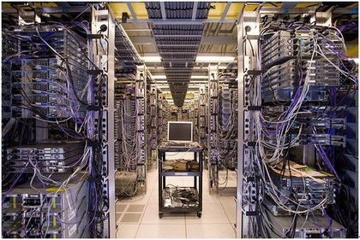
Solution #2: IPv6
New internet protocol uses 16 byte addresses
2¹²⁸ addresses: will we ever run out?
Main problem: how to switch over

Slide 8
Domain Names
Domain names: alternate host identification for human convenience (added in 1983)
Each valid domain string corresponds to some IP address representing a host
TLD are categories (.com, .org) or countries (.us, .cn)
Domains correspond to owners/entities (traditionally!)
Subdomains at the discretion of each domain owner
cs.smith.edu
Subdomain
Domain
Top-level domain (TLD)

Slide 9
Directory Name Service
DNS servers respond to request for IP addresses
Local DNS caches results from authoritative servers
Lab: nslookup
“Where’s en.wikipedia.org?”
Authoritative Sources
Root nameserver
[198.41.0.4]
“.org?”
Client
Local DNS

Slide 10
Directory Name Service
DNS servers respond to request for IP addresses
Local DNS caches results from authoritative servers
Lab: nslookup
“Where’s en.wikipedia.org?”
Authoritative Sources
Root nameserver
[198.41.0.4]
“.org?”
Client
Local DNS
“Ask 204.74.112.1”
“wikipedia.org?”
.org nameserver
[204.74.112.1]

Slide 11
Directory Name Service
DNS servers respond to request for IP addresses
Local DNS caches results from authoritative servers
Lab: nslookup
“Where’s en.wikipedia.org?”
Authoritative Sources
Root nameserver
[198.41.0.4]
“.org?”
Client
Local DNS
“Ask 204.74.112.1”
“wikipedia.org?”
.org nameserver
[204.74.112.1]
“Ask 207.142.131.234”
“en.wikipedia.org?”
wikipedia.org nameserver
[207.142.131.234]

Slide 12
Directory Name Service
DNS servers respond to request for IP addresses
Local DNS caches results from authoritative servers
Lab: nslookup
“Where’s en.wikipedia.org?”
Authoritative Sources
Root nameserver
[198.41.0.4]
“.org?”
Client
Local DNS
“Ask 204.74.112.1”
“wikipedia.org?”
.org nameserver
[204.74.112.1]
“Ask 207.142.131.234”
“en.wikipedia.org?”
wikipedia.org nameserver
[207.142.131.234]
“It’s at 207.142.131.234”

Slide 13
Directory Name Service
DNS servers respond to request for IP addresses
Local DNS caches results from authoritative servers
Lab: nslookup
Authoritative Sources
Root nameserver
[198.41.0.4]
Client
Local DNS
.org nameserver
[204.74.112.1]
Client 2
“It’s at 207.142.131.234”
“Where’s en.wikipedia.org?”
wikipedia.org nameserver
[207.142.131.234]

Slide 14
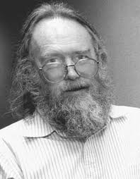
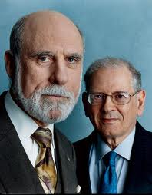
Internet Governance
Early Internet developed by small group of interested parties
Example: one man in charge of domain names!
Government funded but gave little direction
Mostly US control
With growth, pressure for more formal system
Technical development
Policy development
Jon Postel
Vint Cerf & Bob Kahn

Slide 15
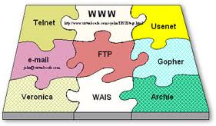

Technical Development
Standards developed through RFC process
RFC = Request For Comment
Initial drafts revised using community feedback
After consensus, are adopted as standard
Began as informal, academic process
Now overseen by IETF/IESG (Internet Engineering Task Force/Steering Group)

Slide 16
Internet Policy & Administration
ICANN formed 1998
IANA contracts with private registrars
IP addresses: 5 regional internet registries
Domain names: contractors run Network Information Centers
Retail registrars file with NIC for each domain
ICANN
International Corporation for Assigned Names and Numbers
IANA
Internet Assigned Numbers Authority
RIR
Regional Internet Registry
NIC
Network Information Center
Domain Name Registrar
Domain Name Registrar

